Slide 1
Job or Jab? Exposing the Hidden Scams in Online Job Postings
Aamir Hassan Shah, Allison McCollum, Deysi Paniagua, James Ward

Slide 2
Project Aim
Our goal is to detect patterns in fake job postings using data analysis and machine learning. We explore how fraudulent listings differ from genuine ones and aim to build a classification model using natural language processing.

Slide 3
Dataset Overview
Our data source was from kaggle.com (Link)
Some of the variables explored included: job title, location, department, salary range, company profile, job description, requirements, benefits, telecommuting, employment type (e.g., full-time, part-time, etc.), required experience and education, industry, function
Does the company have a logo?
Does the job posting have questions?
Fraudulent: Is the job posting fraudulent vs. legitimate

Slide 4
Key Questions We Aim to Answer
Can metadata (e.g., title, location, salary) predict fakes?
Are there common linguistic clues in fake listings?
Do fake jobs cluster in certain industries or regions?
How do fake postings vary over time or across platforms?

Slide 5
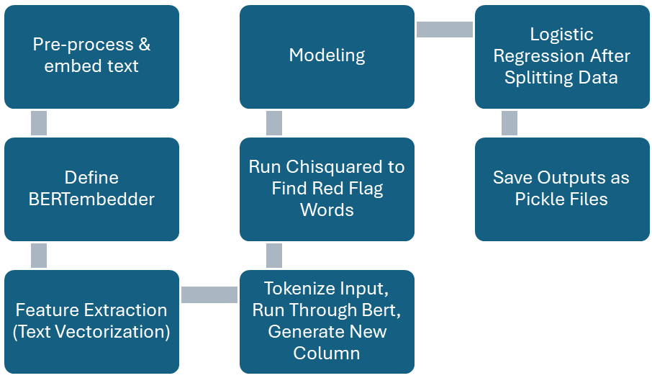
Project Flow Chart

Slide 6
Project Methodology
Data Preprocessing: Text cleaning, handling missing values
Tokenization: DistilBERT tokenizer
Feature Extraction: From job descriptions
Model: Fine-tuned DistilBERT on fake/real labels
Training: Supervised learning with batching
Evaluation Metrics: Accuracy, F1-score, Confusion Matrix
Tools Used: BERT, DistilBERT, Chi-square feature selection
Workflow: End-to-end pipeline from raw text to classification

Slide 7
BERT vs. DistilBERT: Key Models in NLP
BERT (Bidirectional Encoder Representations from Transformers)
What: Google’s pre-trained model using bidirectional transformer architecture
Why Useful: Deep contextual understanding improved classification accuracy and NLU tasks
DistilBERT
What: A compressed version of BERT via model distillation
Why Useful: 60% faster, 40% smaller, retains 97% of BERT’s performance — ideal for fast, efficient deployment

Slide 8
Supporting Techniques in NLP Modeling
Chi-Square Test
What: Statistical method for identifying relevant categorical features
Why Useful: Reduced dimensionality, improved efficiency of ML models
Pipeline
What: Streamlined sequence of preprocessing and modeling steps
Why Useful: Ensured consistency, reusability, and easier experimentation
Batching
What: Splitting data into smaller chunks during training
Why Useful: Improved computational efficiency and memory usage
Notes:
What it is:
Batch size refers to the number of training examples used in one iteration during model training. A batch size of 32 is a common compromise between stability and training speed.
Why batch size 32 is significant:
A batch size of 32 is a commonly used default that offers a solid balance between performance and efficiency:
• Small enough to fit into memory on most hardware setups, including GPUs.
• Large enough to stabilize the gradient updates, reducing noise while still allowing the model to generalize well.
• Often leads to faster convergence and more reliable training behavior compared to very small or very large batch sizes.
This choice made training smoother and more consistent without requiring excessive computing resources.
A batch size of 32 provided a good balance between memory usage and gradient estimation stability. It helped the model converge efficiently while avoiding overfitting or excessive computational cost. Which is why we selected it.

Slide 9
Interpreting BERT+PIPELINE Data
1. Text Preprocessing
Cleaning: Remove special characters, HTML tags, and stopwords.
Tokenization: Split text into words/subwords.
Lowercasing & Lemmatization: Normalize text for consistency.
2. Embedding with BERT
Contextual Understanding: BERT converts text into dense vector representations, capturing word meaning based on context.
[CLS] Token: The first token’s embedding is often used as the summary of the entire input (for classification tasks).
3. Classification Pipeline
Model Input: Preprocessed job descriptions and metadata fed into BERT.
Classifier Head: Outputs a probability score—fake or genuine.
Training: Supervised learning with labeled job posting data.

Slide 10
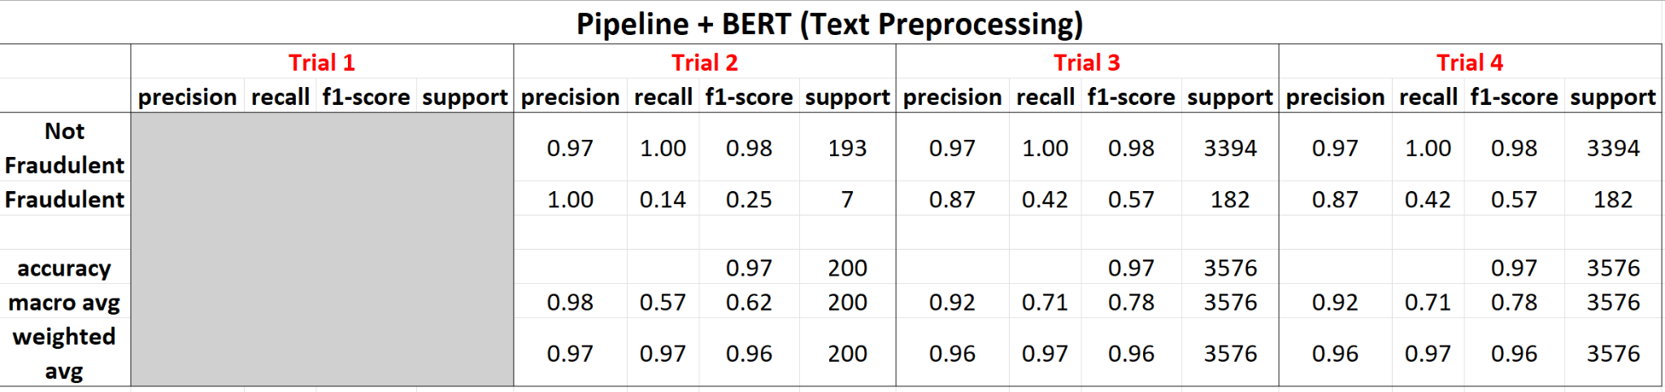
BERT+PIPELINE Data Cont.
Notes:
Dropped rows where description column was blank
Trial 1: Included only 100 rows of our dataset
Trial 2: Included 1000 rows to ensure that the model ran adequately, once good, moved on to trial 3
Trial 3: Included the entire dataset, data pickling (allowed us to save our output w/o running the model again), batching size to 32
-Data pickling was extremely important because of our large dataset which often took 8-24 hours to run
Trial 4: Entire dataset, everything James previously presented, data pickling,
Classification Report

Slide 11
Interpreting TF-IDF Scores
TF-IDF scores are calculated by multiplying term frequency (TF) and inverse document frequency (IDF). TF represents how often a term appears in a specific document, while IDF reflects how rare or common the term is across a collection of documents.
A high TF-IDF score indicates that a term is both frequent within a specific document (high TF) and rare across the overall corpus (high IDF), suggesting it's a significant and unique term for that document.
Notes:
TF-IDF (Term Frequency-Inverse Document Frequency) scores are a numerical statistic used to evaluate the importance of a word in a document relative to a collection of documents

Slide 12
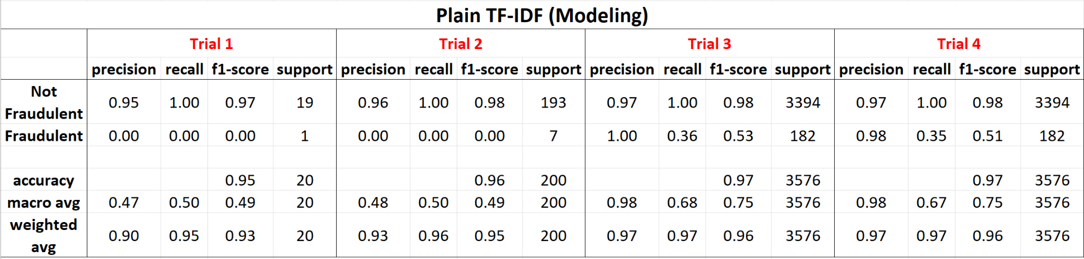
Model Performance & Evaluation
Notes:
Logistic Regression

Slide 13
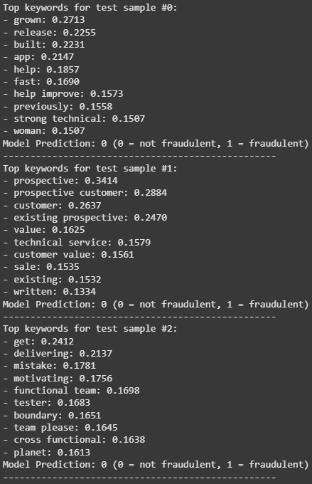
Top Keywords w/Corresponding TF-IDF score

Slide 14
Chi-Square Data
Work home
Data entry
Ultra luxury
Earn
Extra
Wage
Money
Earnings
Representative position
Cash
Comfort
Desirable
Exciting challenge
New Exciting
Part Time
Offshore
Free
Guarantee
Work time

Slide 15
Expected Deliverables
A trained model to detect fake job postings
Insights into patterns of employment fraud
Visualizations showing key trends
Potential tools for real-world application

Slide 16
Potential Impact
Help job seekers avoid scams
Improve trust in online job platforms
Aid companies and governments in fraud detection
Contribute to safer, more transparent hiring processes

Slide 17
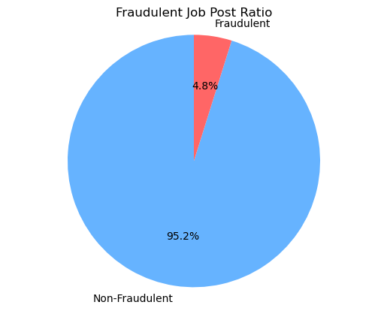
Data Limitations
Our dataset was not diverse enough to effectively train the model because it has more real jobs.
Notes:
Real Jobs: 17,015
Fraudulent Jobs: 867

Slide 18
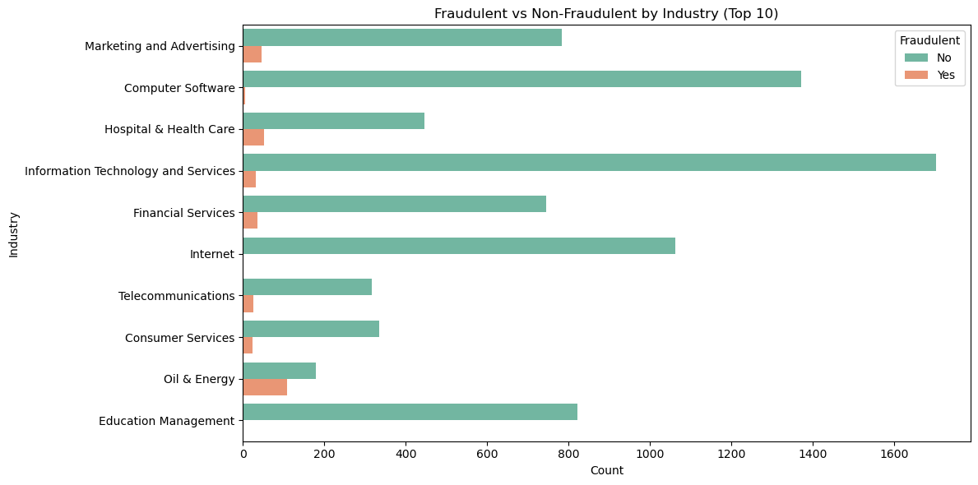
Data Limitations Cont.
With better data we could continue to use other factors such as industry to be a predictor.
Moreover, we could leverage the TF-IDF score to compile a graph, like the example, instead of counting.

Slide 19
Limitations
1. Imbalanced Dataset
Majority of posts are real, causing model bias
High accuracy can be misleading if fake posts are rarely detected
2. Limited Contextual Data
Missing platform, user, and time-based features
Reduces model's ability to detect deeper scam patterns
3. Overfitting Risk
Small datasets + powerful models = memorization over generalization
Requires regularization and cross-validation
Notes:
SMOTE: Would’ve allowed us to resample and balance our data to obtain greater precision, recall, f1-score, and accuracy scores

Slide 20
Limitations
4. Limited Interpretability
Transformer models like DistilBERT are "black boxes"
Hard to explain why a post is flagged
5. Generalization Issues
Model trained on one source may not work on others (e.g., LinkedIn, Craigslist)
Needs domain adaptation or transfer learning
6. Computational Cost
DistilBERT is lighter than BERT but still GPU-intensive
Limits usage for low-resource environments
Notes:
SMOTE: Would’ve allowed us to resample and balance our data to obtain greater precision, recall, f1-score, and accuracy scores

Slide 21
Handling Class Imbalance with SMOTE
SMOTE: Synthetic Minority Oversampling Technique
Generates synthetic "fake" examples to balance the dataset
Helps avoid model bias towards "real" jobs
Limitations of SMOTE:
May create unrealistic samples
Risk of overfitting if not tuned properly
Notes:
SMOTE: Would’ve allowed us to resample and balance our data to obtain greater precision, recall, f1-score, and accuracy scores

Slide 22
Sources
https://www.indeed.com/career-advice/finding-a-job/how-to-know-if-a-job-is-a-scam
https://www.kaggle.com/datasets/shivamb/real-or-fake-fake-jobposting-prediction
https://aws.amazon.com/what-is/nlp/#:~:text=Natural%20language%20processing%20(NLP)%20is%20critical%20to%20fully%20and%20efficiently,day%2Dto%2Dday%20conversations
https://github.com/resources/articles/ai/natural-language-processing

Slide 23

Questions

